Slide 1
EXPERIMENTAL INVESTIGATION ON MECHANICAL AND WEAR CHARACTERSTATICS OF AZ91 HYBRID COMPOSITES PRODUCED THROUGH FRICTION STIR PROCESSING
Team Members
Shaik Mohammed Sadiq (21765A0334)
Pathan Mastan Khan (21765A0331)
Anaparthi Tarun Eswar Manikanta (21765A0321)
Under The Guidance Of
A. Dhanunjay Kumar
Sr. Asst. Professor

Slide 2
CONTENT
Abstract
Introduction
Literature Review
Research Gap
Objectives
Experimentation
Results and Discussions
Conclusion

Slide 3
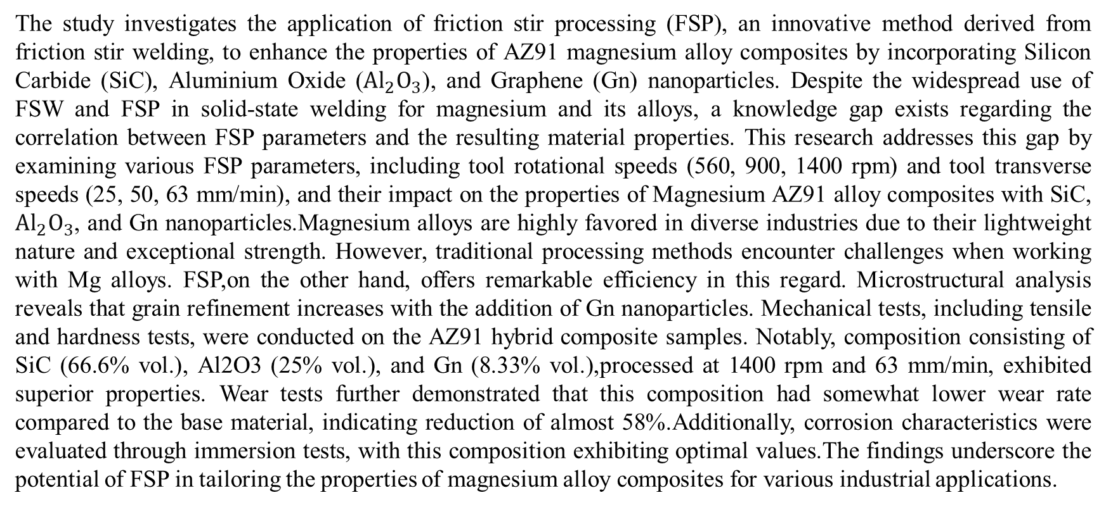
ABSTRACT
The study investigates the application of friction stir processing (FSP), an innovative method derived from friction stir welding, to enhance the properties of AZ91 magnesium alloy composites by incorporating Silicon Carbide (SiC), Aluminium Oxide (${Al}_{2}O_{3}$), and Graphene (Gn) nanoparticles. Despite the widespread use of FSW and FSP in solid-state welding for magnesium and its alloys, a knowledge gap exists regarding the correlation between FSP parameters and the resulting material properties. This research addresses this gap by examining various FSP parameters, including tool rotational speeds (560, 900, 1400 rpm) and tool transverse speeds (25, 50, 63 mm/min), and their impact on the properties of Magnesium AZ91 alloy composites with SiC, ${Al}_{2}O_{3}$, and Gn nanoparticles.Magnesium alloys are highly favored in diverse industries due to their lightweight nature and exceptional strength. However, traditional processing methods encounter challenges when working with Mg alloys. FSP,on the other hand, offers remarkable efficiency in this regard. Microstructural analysis reveals that grain refinement increases with the addition of Gn nanoparticles. Mechanical tests, including tensile and hardness tests, were conducted on the AZ91 hybrid composite samples. Notably, composition consisting of SiC (66.6% vol.), Al2O3 (25% vol.), and Gn (8.33% vol.),processed at 1400 rpm and 63 mm/min, exhibited superior properties. Wear tests further demonstrated that this composition had somewhat lower wear rate compared to the base material, indicating reduction of almost 58%.Additionally, corrosion characteristics were evaluated through immersion tests, with this composition exhibiting optimal values.The findings underscore the potential of FSP in tailoring the properties of magnesium alloy composites for various industrial applications.

Slide 4
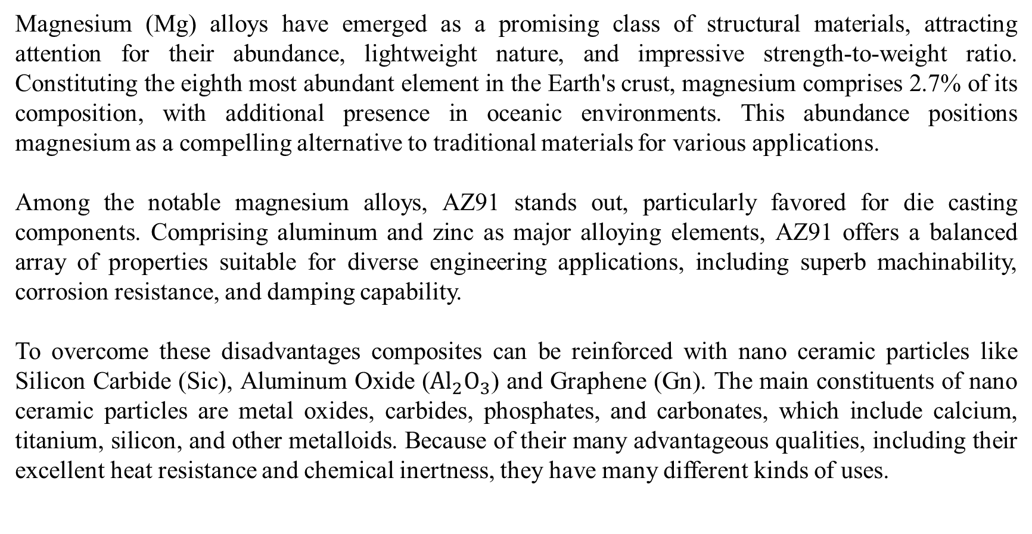
INTRODUCTION
Magnesium (Mg) alloys have emerged as a promising class of structural materials, attracting attention for their abundance, lightweight nature, and impressive strength-to-weight ratio. Constituting the eighth most abundant element in the Earth's crust, magnesium comprises 2.7% of its composition, with additional presence in oceanic environments. This abundance positions magnesium as a compelling alternative to traditional materials for various applications.
Among the notable magnesium alloys, AZ91 stands out, particularly favored for die casting components. Comprising aluminum and zinc as major alloying elements, AZ91 offers a balanced array of properties suitable for diverse engineering applications, including superb machinability, corrosion resistance, and damping capability.
To overcome these disadvantages composites can be reinforced with nano ceramic particles like Silicon Carbide (Sic), Aluminum Oxide (${Al}_{2}O_{3}$) and Graphene (Gn). The main constituents of nano ceramic particles are metal oxides, carbides, phosphates, and carbonates, which include calcium, titanium, silicon, and other metalloids. Because of their many advantageous qualities, including their excellent heat resistance and chemical inertness, they have many different kinds of uses.

Slide 5
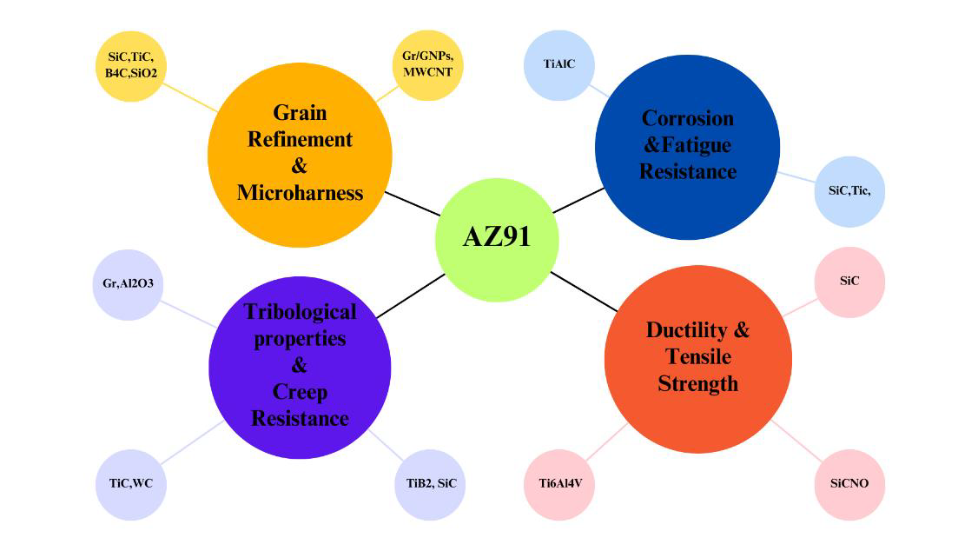
A few studies looked at the use of AZ91 in conjunction with the various reinforcing materials shown in figure 1. This study is focused on different compositions of Silicon carbide, Aluminium oxide and Graphene.
Figure 1: Several reinforcing materials were employed in studies to enhance AZ91's characteristics.

Slide 6
Despite the many benefits of magnesium matrix composites reinforced with nano ceramic particles, dispersing the particles evenly into the magnesium matrix proved difficult using traditional liquid or powder metallurgy processes due to the tendency of the substantial surface area of the ceramic nanoparticles to accumulate and the generally poor wetting between the ceramic particles and the magnesium matrix.
While there are numerous methods for assisting in the dispersion of nano ceramic particles in the melt magnesium during the liquid fabrication process, such as mechanical stirring in a semisolid state and ultrasonic wave melt treatment, these particles tend to be pushed rather than captured by the solidification front and ultimately gather at the grain boundaries in the solidified composites.
In recent years, there has been significant advancement in novel techniques such as FSP (Friction Stir Processing). These processes have emerged as promising methods for enhancing material properties, offering distinct advantages including reduced welding defects, minimal distortion and residual stresses, limited structural alterations, and the generation of a fine-grained structure. Developed by TWI in 1991, FSW was initially introduced to enhance the structural integrity of welded metals, with Friction Stir Processing (FSP) later stemming from this innovation.
Figure 2 illustrates the several tool designs that Friction Stir Processing (FSP) uses to achieve its material processing goals. Square cylindrical tools are among these types; they have a square cross-section and are useful in applications where square characteristics are needed.

Slide 7
With their triangular cross-sections, triangle cylindrical tools have several benefits, like enhancing heat dissipation or encouraging particular flow patterns. Straight cylindrical tools are widely utilized in various FSP applications due to their versatility and lack of specialized geometric properties. Long-shaft cylindrical tools with threads improve material agitation and mixing during processing; this is especially useful for some material compositions. The tapered shape of tapered cylindrical tools allows for controlled material flow and heat dispersion, as well as progressive material displacement. Every tool design fulfills a certain purpose and is chosen depending on material properties and desired processing outcomes in FSP operations.
Figure 2: Different types of Friction Stir Processing tools

Slide 8
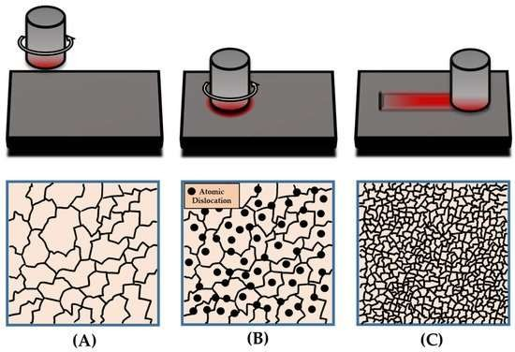
FSW and FSP offer significant advantages by joining materials in a solid-state manner, reducing welding defects and structural distortions. The controlled heating and stirring action lead to favorable microstructural changes, improving material properties. These techniques represent pivotal advancements in material processing, serving diverse industrial applications. Variables notably influence mechanical, microstructural, wear, corrosion, and friction properties, with grain refinement customizing these traits. Dynamic recrystallization (DRX) plays a crucial role in altering microstructures, with four sub-mechanisms identified: discontinuous DRX (DDRX), geometric DRX (GDRX), twinning-induced DRX (TDRX), and continuous DRX (CDRX). DRX occurs through strain-induced deformation, prompting atom dislocation and grain re-nucleation, thereby enhancing microstructural properties. The general concept of DRX via FSP processes is illustrated in Figure 3.
Figure-3: A schematic of the dynamic recrystallization process consisting of the (A) material in its base form, (B) the initial plunge into the working material, thus inducing severe atomic dislocations (shown by circles), (C) the reorientation of the atomic structure and the finalized grain structure.

Slide 9
APPLICATIONS
As discussed earlier, Mg-based alloys and FSW and FSP methods are used in various industries. Because Mg-based alloys have a high strength-to-weight ratio, they are extensively used in the automobile industry. The applications of FSW/FSP technique in various fields could be observed in Figure 4 . Other principal utilization of Mg alloys, as well as the FSW/FSP technique could be illustrated as follows:
Construction industries such as pipelines, bridges, reactors for power plants, and frames.
Railway industries such as container bodies, trams, wagons, and underground carriages.
Land transportations such as track bodies, engine chassis, tail lifts for tracks, wheel rims, body frames, fuel tankers, and mobile cranes.
Shipbuilding and marine industries such as marine and transport structures, panels for decks and floors, masts and booms for sailing boats, helicopter platforms, hulls and superstructures, and offshore accommodation.
Aerospace industries such as cryogenic tanks for space vehicles, wings, aviation fuel tanks, fuselages, and fuel tanks.

Slide 10
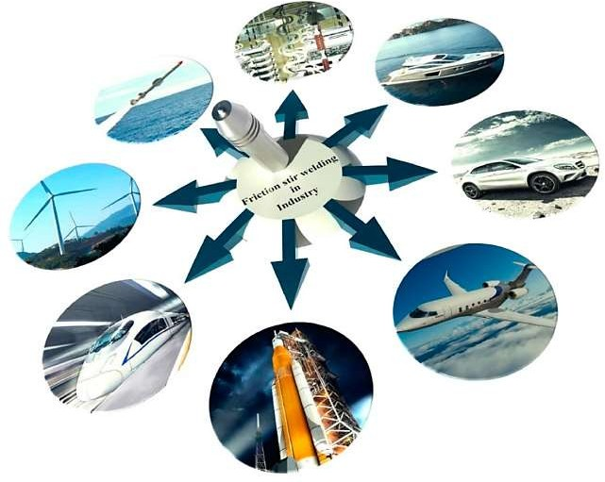
Figure 4: Applications of FSW/FSP technique in railway, aerospace, automotive, renewable energy,
shipbuilding and marine, and defense industries.

Slide 11
LITERATURE REVIEW
1. Journal Title: Mishra, R. S., Ma, Z. Y., & Charit, I.'s Seminal: A foundation laid for understanding FSP's capabilities and its impact on surface composite fabrication.
Friction-stir processing (FSP), an extension of friction-stir welding (FSW) pioneered by The Welding Institute (TWI) of the UK, has garnered attention for its ability to induce localized microstructural changes.
Mishra et al. [1] introduced FSP as a novel technique capable of refining grains and preparing nano-crystalline structures in aluminum (Al), magnesium (Mg), and copper (Cu)-based components. Recent studies highlight FSP's potential for fabricating surface composites with enhanced properties. By refining grains and introducing nanoparticles, FSP enables the formation of metal matrix composites (MMCs), leading to improved mechanical, tribological, and corrosion resistance properties.
2. Journal Title: Heidarzadeh, A., Mironov, Kaibyshev, R. Çam, G. Simar, Gerlich, A. Withers. Friction stir welding/processing of metals and alloys: A comprehensive review on microstructural evolution.
Heidarzadeh et al. [2] emphasized that Friction-stir processing (FSP) offers a unique opportunity to refine and homogenize microstructures locally while facilitating the incorporation of nanoparticles to form metal matrix composites (MMCs). These nanoparticles activate particle-stimulated nucleation (PSN) recrystallization, followed by pronounced Zener-pinning, resulting in an ultrafine-grained structure.
Their comprehensive review highlights the potential of FSP in microstructural evolution. The process enables tailored material properties through precise control over grain size and distribution, essential for enhancing mechanical performance. The activation of PSN and subsequent Zener-pinning mechanisms underscores FSP's capability to achieve superior structural refinement, crucial for advancing the development of high-performance materials.

Slide 12
3. Journal Title: Soorya Prakash K, Balasundar P, Nagaraja S, et al. Mechanical and wear behaviour of Mg–SiC–Gn hybrid composites.
K. Soorya Prakash et al. [3] pioneered the development of magnesium–SiC–Gn hybrid composites via powder metallurgy, resulting in heightened hardness compared to the base material due to the robust SiC presence.
However, a slight decline in hardness occurred compared to Mg–SiC composites due to the addition of softer Gn particles. Tribological properties were evaluated via pin-on-disc wear tests under dry sliding conditions, revealing significantly improved wear resistance for the composites compared to pure magnesium.
Soorya Prakash et al.'s study sheds light on the mechanical and wear behavior of these hybrid composites, offering valuable insights into their potential applications.
4. Journal Title: Hsu, C. J., Chang, C. C. Y., Kao, P. W., & Ho, N. J. (2006). Al-Al3Ti nano composites produced in situ by friction stir processing.
Hsu et al. [4] employed friction-stir processing (FSP) to create Al/Al3Ti nano-composites, enhancing the Young's modulus and tensile strength of aluminum alloys.
The study revealed that increasing the volume percentage of Al3Ti resulted in a significant elevation in Young's modulus, indicating the potential of ceramic particles to enhance wear resistance in metal matrix composites.
This research underscores the effectiveness of FSP in producing nano-composites with improved mechanical properties, offering insights into the optimization of composite materials for various applications.

Slide 13
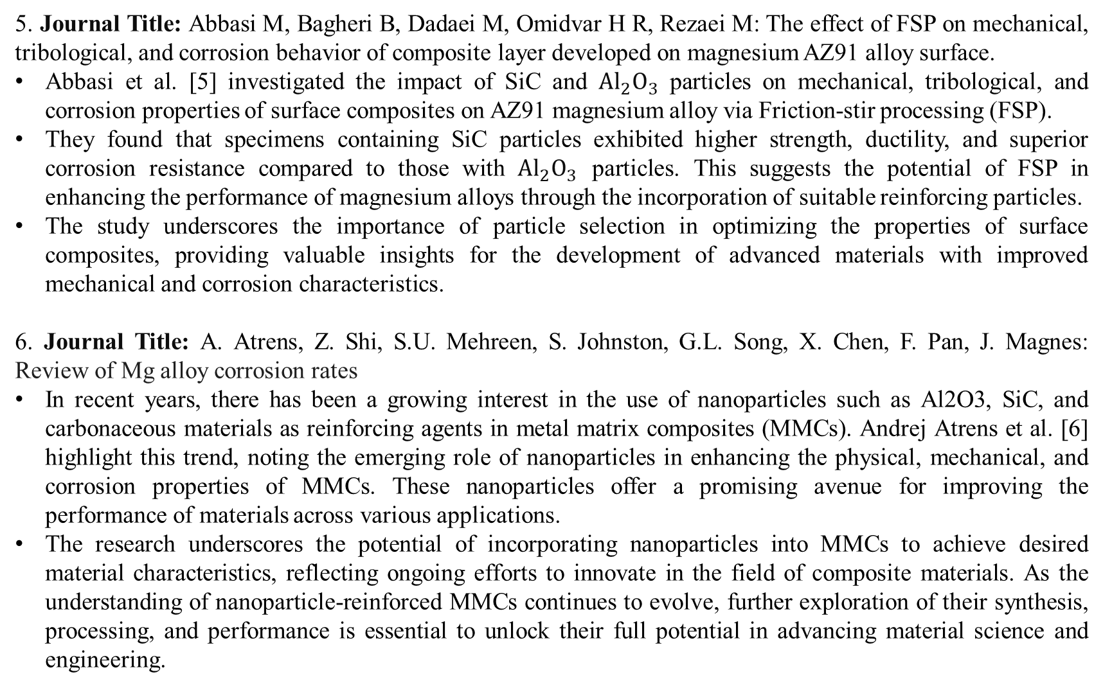
5. Journal Title: Abbasi M, Bagheri B, Dadaei M, Omidvar H R, Rezaei M: The effect of FSP on mechanical, tribological, and corrosion behavior of composite layer developed on magnesium AZ91 alloy surface.
Abbasi et al. [5] investigated the impact of SiC and ${Al}_{2}O_{3}$ particles on mechanical, tribological, and corrosion properties of surface composites on AZ91 magnesium alloy via Friction-stir processing (FSP).
They found that specimens containing SiC particles exhibited higher strength, ductility, and superior corrosion resistance compared to those with ${Al}_{2}O_{3}$ particles. This suggests the potential of FSP in enhancing the performance of magnesium alloys through the incorporation of suitable reinforcing particles.
The study underscores the importance of particle selection in optimizing the properties of surface composites, providing valuable insights for the development of advanced materials with improved mechanical and corrosion characteristics.
6. Journal Title: A. Atrens, Z. Shi, S.U. Mehreen, S. Johnston, G.L. Song, X. Chen, F. Pan, J. Magnes: Review of Mg alloy corrosion rates
In recent years, there has been a growing interest in the use of nanoparticles such as Al2O3, SiC, and carbonaceous materials as reinforcing agents in metal matrix composites (MMCs). Andrej Atrens et al. [6] highlight this trend, noting the emerging role of nanoparticles in enhancing the physical, mechanical, and corrosion properties of MMCs. These nanoparticles offer a promising avenue for improving the performance of materials across various applications.
The research underscores the potential of incorporating nanoparticles into MMCs to achieve desired material characteristics, reflecting ongoing efforts to innovate in the field of composite materials. As the understanding of nanoparticle-reinforced MMCs continues to evolve, further exploration of their synthesis, processing, and performance is essential to unlock their full potential in advancing material science and engineering.

Slide 14
7. Journal Title: Faraji, G., & Asadi, P. Characterization of AZ91/alumina nanocomposite produced by FSP.
Faraji and Asadi (2011) explored AZ91/Al2O3 nano-composite fabrication via friction stir processing (FSP), revealing insights into grain size, hardness, and wear resistance. They found that the distribution pattern of nano-alumina particles, rather than heat production, significantly influenced final grain size and hardness.
Additionally, FSP of AZ91 magnesium alloy with nano-alumina particles notably enhanced wear resistance, transitioning the wear mechanism from intensive to moderate. Moreover, optimizing particle distribution at high W/V ratios led to reduced grain size and increased hardness.
This study underscores the importance of nanoparticle distribution in FSP-produced composites and highlights its potential for enhancing mechanical properties, particularly wear resistance, in magnesium alloys.

Slide 15
Research Gap
Despite the widespread use of Friction Stir Processing (FSP) in solid-state welding for magnesium and its alloys, a significant research gap exists in understanding the co- relation between FSP processing parameters and the resultant surface properties of Magnesium alloy composites with Silicon Carbide (SiC) and Graphene (Gn) nanoparticles.
The current study focuses on AZ91 Mg alloy composites, aiming to enhance their properties through FSP. The lack of comprehensive research on the corrosion behavior, microstructures, and mechanical properties like wear resistance of AZ91 alloy composites produced through FSP, especially with the addition of SiC and Gn nanoparticles. Provide potential advancements in Magnesium alloy applications.

Slide 16
OBJECTIVES
Investigate the application of Friction Stir Processing (FSP) on AZ91 Mg alloy composites by
incorporating Silicon Carbide (SiC) and Graphene (Gn) nanoparticles.
Examine the influence of FSP processing parameters on the surface properties of Mg alloy composites, particularly focusing on the correlation between these parameters and resultant properties.
Evaluate the corrosion behavior of AZ91 alloy composites produced through FSP, considering the
addition of SiC and Gn nanoparticles.
Assess the mechanical properties, including wear resistance and microhardness, of the FSP-treated
AZ91 alloy composites and compare them with the properties of the base metal.
Contribute to bridging the existing gap in knowledge regarding the relationship between FSP processing parameters and surface properties of Mg alloy composites with SiC and Gn nanoparticles.

Slide 17
METHODOLOGY
Literature Study
Material Selection
Friction Stir Processing
Corrosion Behavior Analysis
Microstructural Analysis
Mechanical
Properties Evaluation
Data Comparison and
Analysis

Slide 18
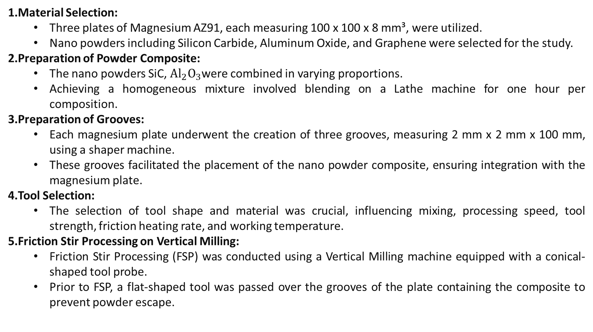
METHODOLOGY
Material Selection:
Three plates of Magnesium AZ91, each measuring 100 x 100 x 8 mm³, were utilized.
Nano powders including Silicon Carbide, Aluminum Oxide, and Graphene were selected for the study.
Preparation of Powder Composite:
The nano powders SiC, ${Al}_{2}O_{3}$were combined in varying proportions.
Achieving a homogeneous mixture involved blending on a Lathe machine for one hour per composition.
Preparation of Grooves:
Each magnesium plate underwent the creation of three grooves, measuring 2 mm x 2 mm x 100 mm, using a shaper machine.
These grooves facilitated the placement of the nano powder composite, ensuring integration with the magnesium plate.
Tool Selection:
The selection of tool shape and material was crucial, influencing mixing, processing speed, tool strength, friction heating rate, and working temperature.
Friction Stir Processing on Vertical Milling:
Friction Stir Processing (FSP) was conducted using a Vertical Milling machine equipped with a conical-shaped tool probe.
Prior to FSP, a flat-shaped tool was passed over the grooves of the plate containing the composite to prevent powder escape.

Slide 19
Subsequently, a conical-shaped tool was employed to execute the FSP, with different tool parameters applied for each composition ranging from 560-1400 rpm and 25-63 mm/min.
The tilt angle for the tool remained constant at 2°.
Post-processing involved the removal of excess material generated during FSP.
Cutting of Specimens:
Markings were made on the FSPed Plates to facilitate various tests on the processed composites.
Wire Electrical Discharge Machining (WEDM) was utilized to cut different specimens.
Hardness Test:
The Brinell hardness test method was employed to measure the diameter of the impression left on the material surface after applying a predetermined load.
The test involved forcing a hard steel ball indenter into the substance under test using calibrated equipment.
Tensile Test:
A standard tensile test was conducted to determine material behavior under tension.
Key characteristics including yield strength, ultimate tensile strength, elongation, and modulus of elasticity were determined.
Wear Test:
The pin-on-disk test method was used to evaluate friction and wear properties.
A DUCOM TR-20LE wear testing machine was employed, incorporating various components such as pins, discs, load systems, motion control systems, environmental control systems, and data acquisition systems. Standardized testing ASTM-G99 procedures were followed to ensure consistency and accuracy in test results.

Slide 20
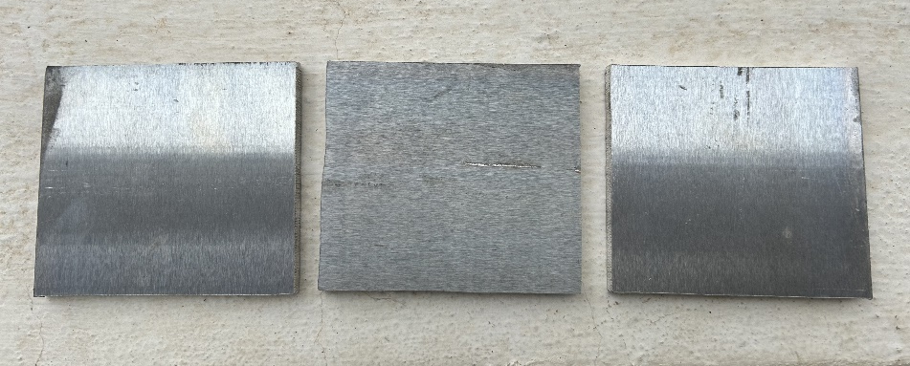
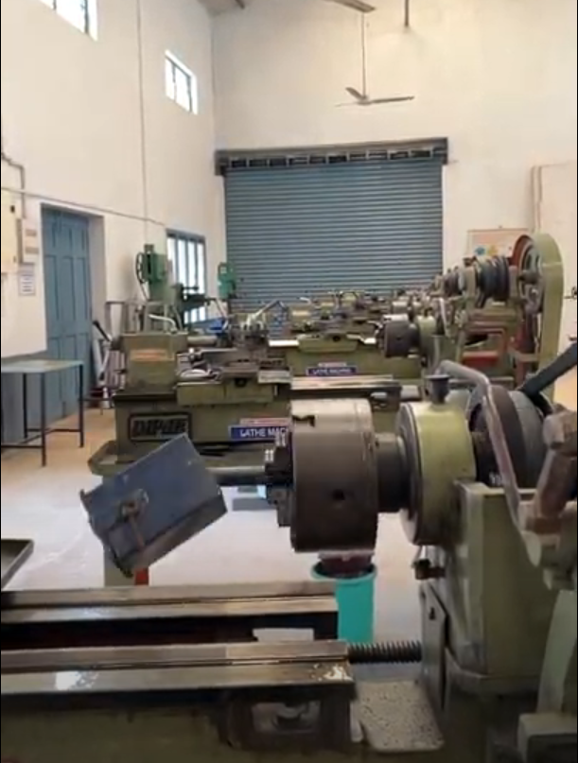
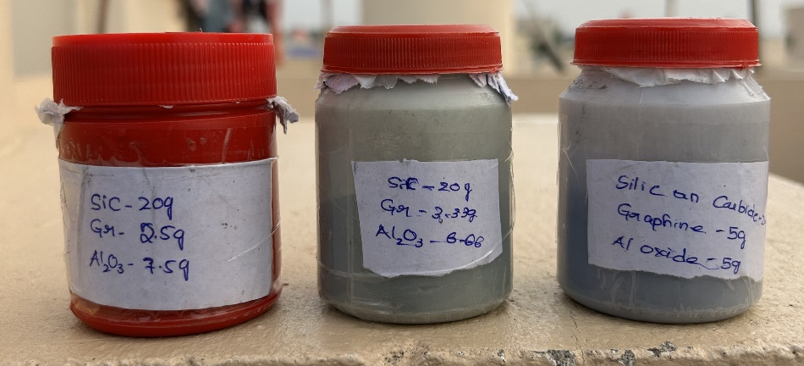
EXPERIMENTATION SETUP
Material Slection and Preparation of Nano Powder Composition: The AZ91 workpiece is to be cut into plates of dimensions 100x100x8 mm³ pieces for FSP with the help of hand saw and hand cutter into three plates. A nano powder composition of three different materials (Silicon Carbide, Aluminium Oxide and Graphene) are mixed together in three proportions. These compositions are placed in different containers and blended on lathe machine until homogenously mixed.
Figure 5: Workpiece, Compositions and Blending of compositions on lathe

Slide 21
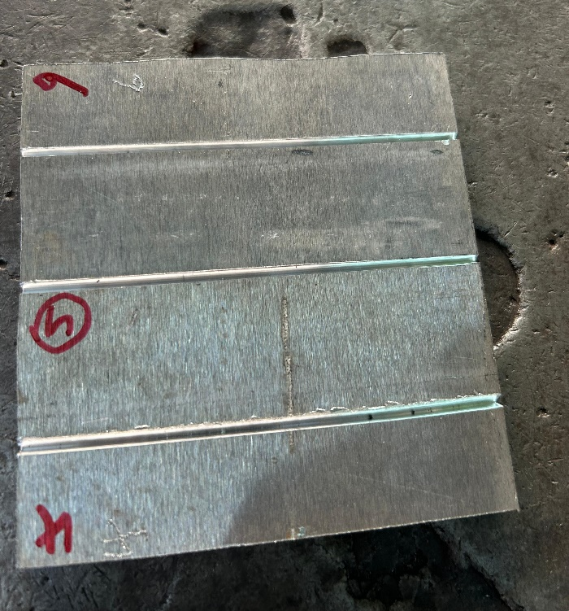
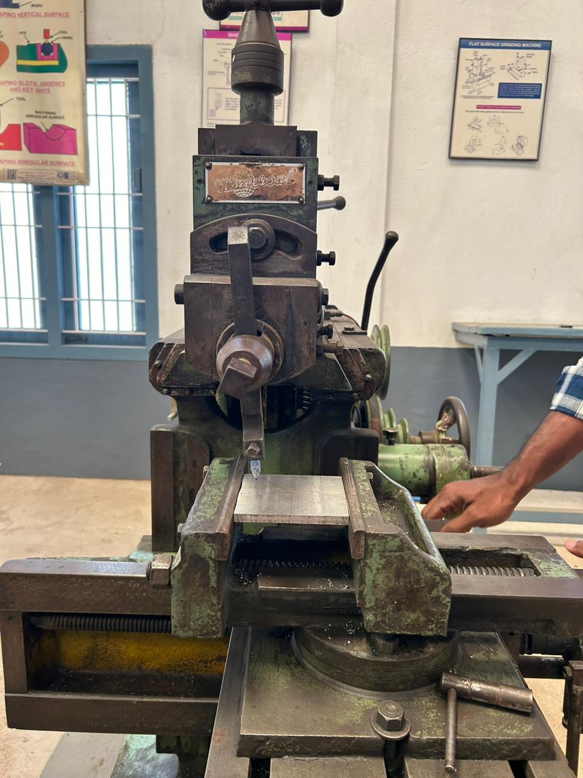
Preparation of Grooves
The preparation of the grooves for place the composite powder on fsp Each plate underwent the creation of three grooves, measuring 2 mm x 2 mm x 100 mm, utilizing a shaper machine. These grooves facilitated the placement of the nano powder composite, ensuring its integration with the magnesium plate.
Figure 6: grooves plate and shaper machine

Slide 22
Volume Percentages of The Nano Powder Composite
Composite Material | Volume %
 | I | II | III
Silicon Carbide (SiC) | 66.6% | 66.6% | 66.6%
Aluminium Oxide (Al₂O₃) | 16.6% | 22.2% | 25%
Graphene (Gn) | 16.6% | 11.1% | 8.33%

Slide 23
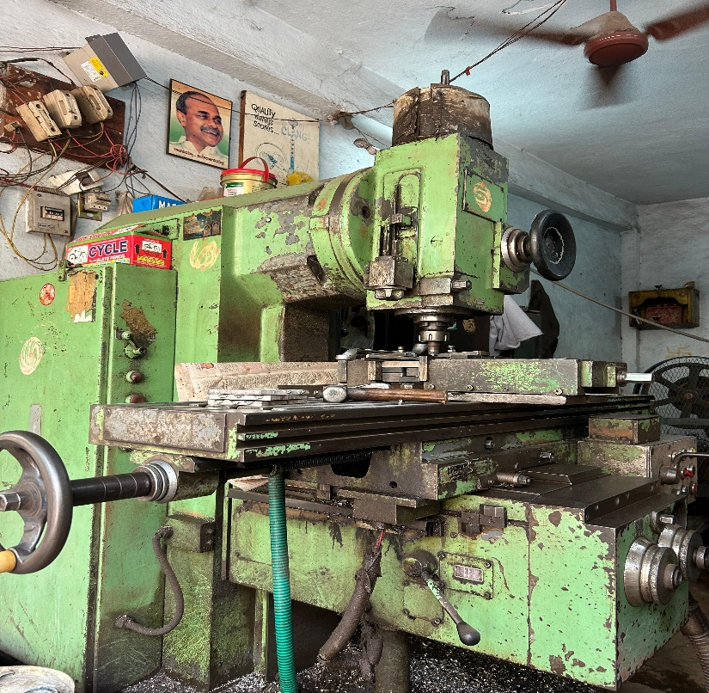
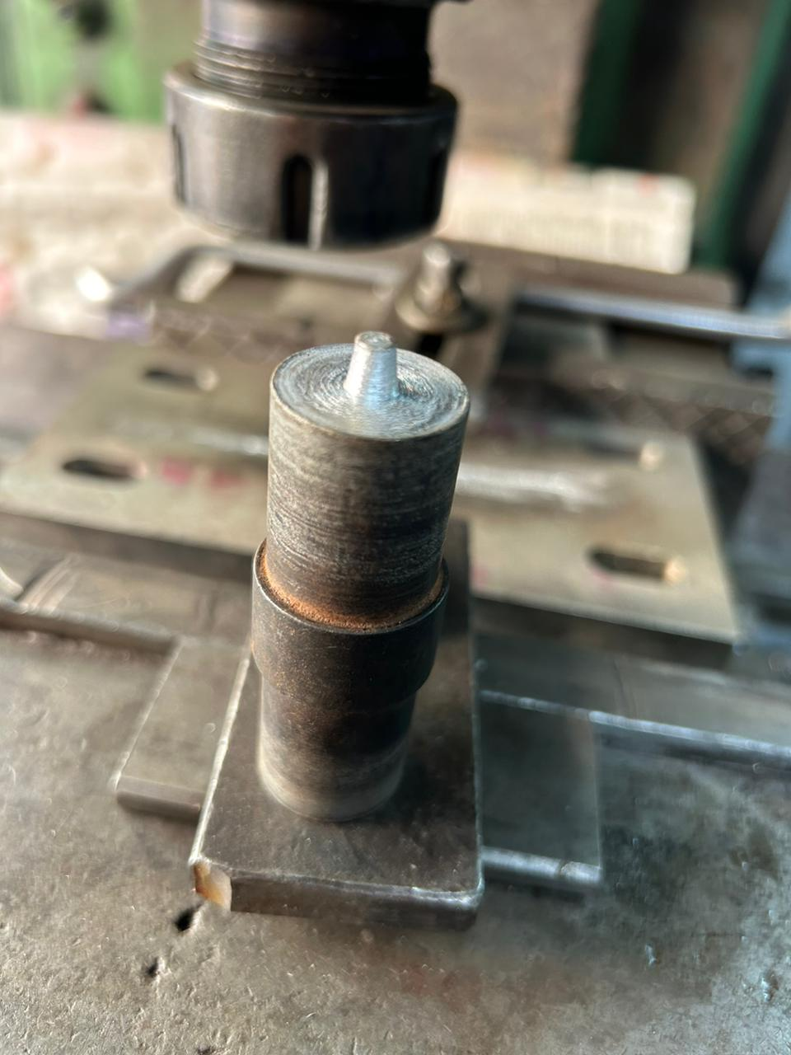
Friction Stir Processing
Friction Stir Processing (FSP) was conducted using a Vertical Milling machine equipped with a conical-shaped tool probe as shown in figure 6. Preceding the FSP, a flat-shaped tool was passed over the grooves of the plate containing the composite to prevent powder escape. Subsequently, a conical-shaped tool, as depicted in the figure, was employed to execute the FSP. Different tool parameters were applied for each composition, ranging from 560 to 1400 rpm and 25 to 63 mm/sec, as detailed in below table. The tilt angle for the tool remained constant at 2°. Post-processing involved the removal of excess material generated during the FSP.
Figure 7: vertical milling machine and FSP tool

Slide 24
Weight ratios of Compositions and Design of Experimentation Tables
Sl. No. | Composite | Rotational Speed (RPM) | Transvers Speed (mm/sec) | Angle
1 | I | 560 | 25 | 2º
2 | I | 900 | 50 | 2º
3 | I | 1400 | 63 | 2º
4 | II | 1400 | 63 | 2º
5 | II | 560 | 25 | 2º
6 | II | 900 | 50 | 2º
7 | III | 900 | 50 | 2º
8 | III | 1400 | 63 | 2º
9 | III | 560 | 25 | 2º

Slide 25
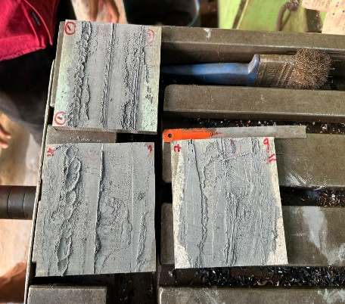
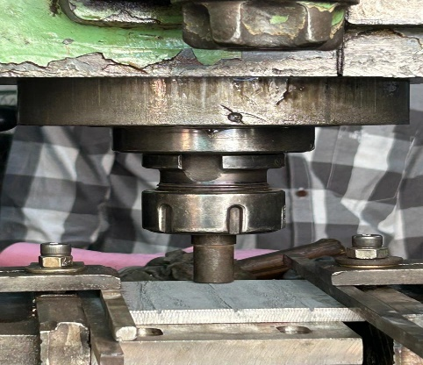
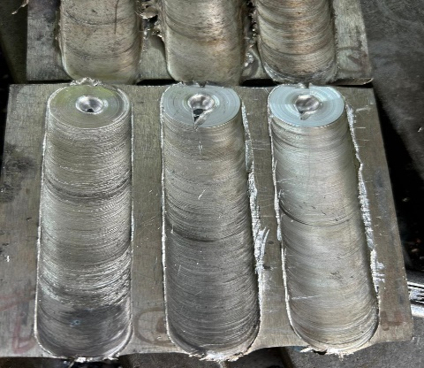
Process of friction stir process
Figure 7: process of FSP

Slide 26
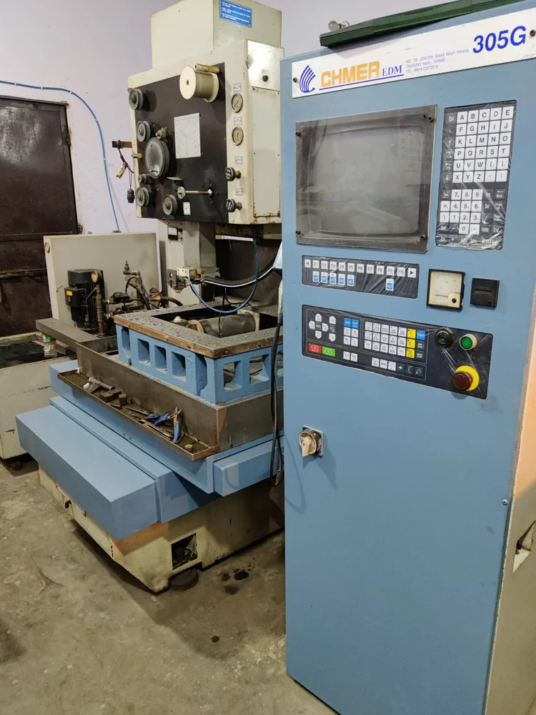
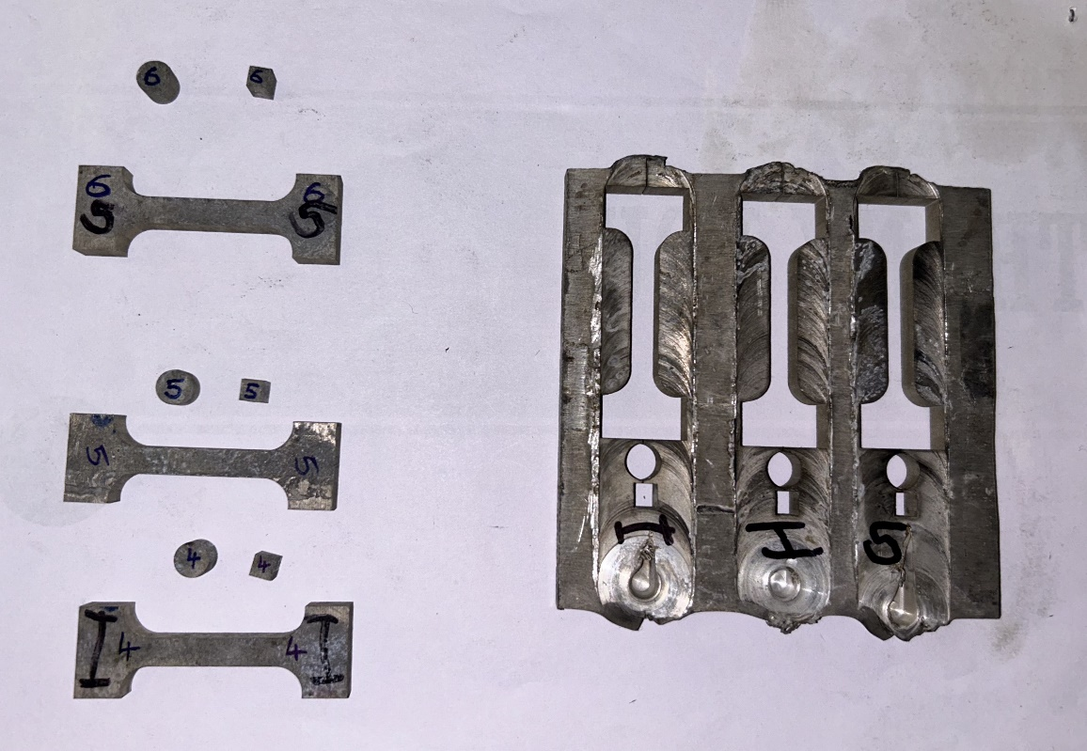
Wire Cutting of Specimen
To facilitate various tests on the processed composites, markings were made on the FSPed Plates. Utilizing the Wire electrical discharge machining (WEDM) method, different specimens were cut, as illustrated in the figure 8. WEDM uses a metallic wire to cut or shape a workpiece, often a conductive material, with a thin electrode wire that follows a precisely programmed path.
Figure 8: Wire electrical discharge machining (WEDM) and specimens

Slide 27
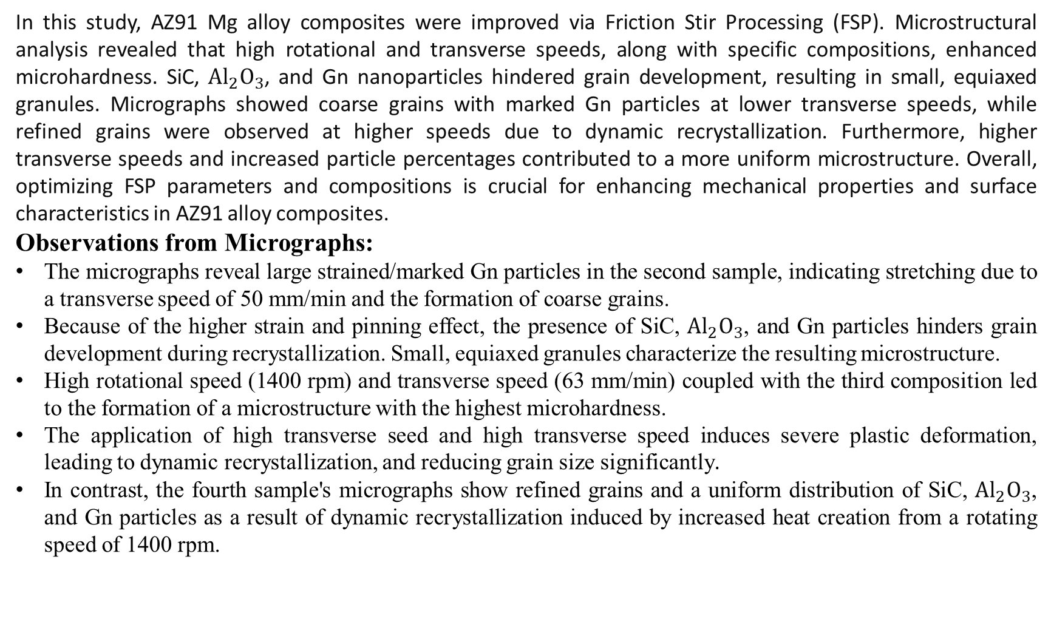
RESULTS AND DISCUSSION
In this study, AZ91 Mg alloy composites were improved via Friction Stir Processing (FSP). Microstructural analysis revealed that high rotational and transverse speeds, along with specific compositions, enhanced microhardness. SiC, ${Al}_{2}O_{3}$, and Gn nanoparticles hindered grain development, resulting in small, equiaxed granules. Micrographs showed coarse grains with marked Gn particles at lower transverse speeds, while refined grains were observed at higher speeds due to dynamic recrystallization. Furthermore, higher transverse speeds and increased particle percentages contributed to a more uniform microstructure. Overall, optimizing FSP parameters and compositions is crucial for enhancing mechanical properties and surface characteristics in AZ91 alloy composites.
Observations from Micrographs:
The micrographs reveal large strained/marked Gn particles in the second sample, indicating stretching due to a transverse speed of 50 mm/min and the formation of coarse grains.
Because of the higher strain and pinning effect, the presence of SiC, ${Al}_{2}O_{3}$, and Gn particles hinders grain development during recrystallization. Small, equiaxed granules characterize the resulting microstructure.
High rotational speed (1400 rpm) and transverse speed (63 mm/min) coupled with the third composition led to the formation of a microstructure with the highest microhardness.
The application of high transverse seed and high transverse speed induces severe plastic deformation, leading to dynamic recrystallization, and reducing grain size significantly.
In contrast, the fourth sample's micrographs show refined grains and a uniform distribution of SiC, ${Al}_{2}O_{3}$, and Gn particles as a result of dynamic recrystallization induced by increased heat creation from a rotating speed of 1400 rpm.

Slide 28
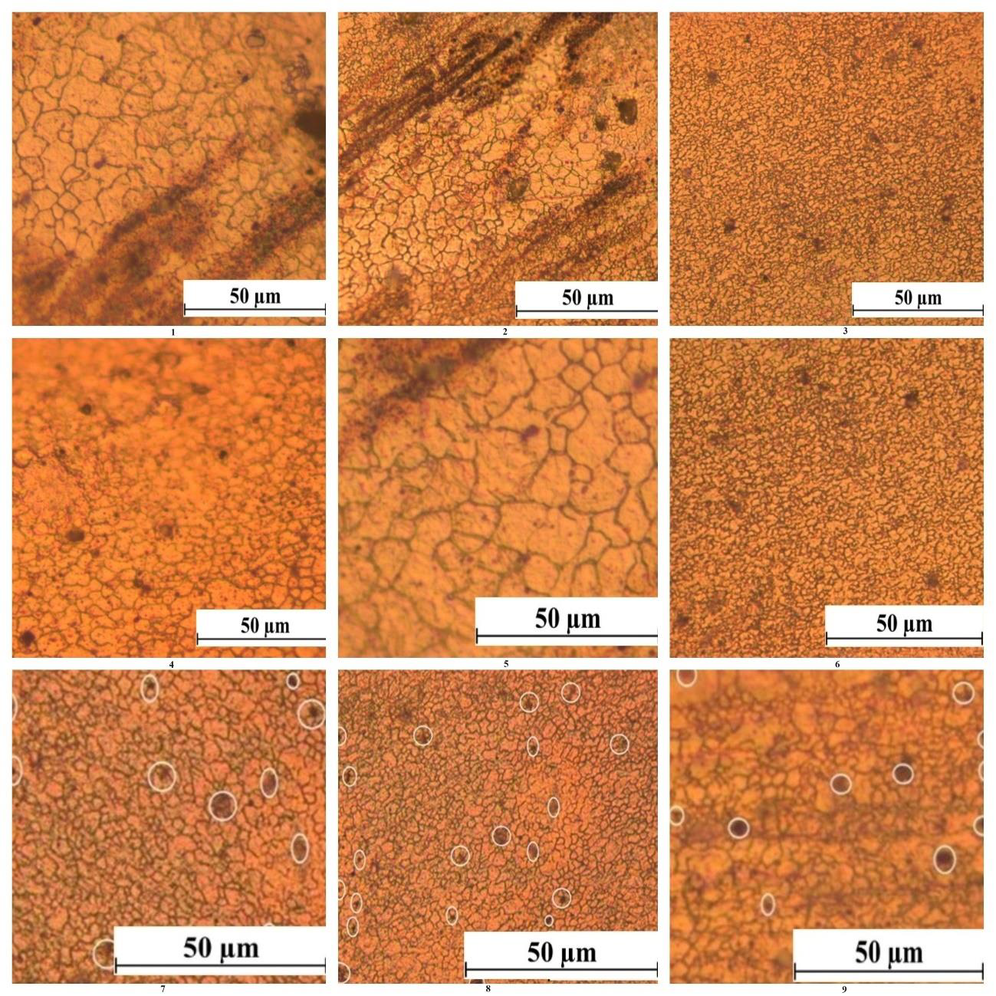
Figure 9: Micrographs of FSPed composite specimens

Slide 29
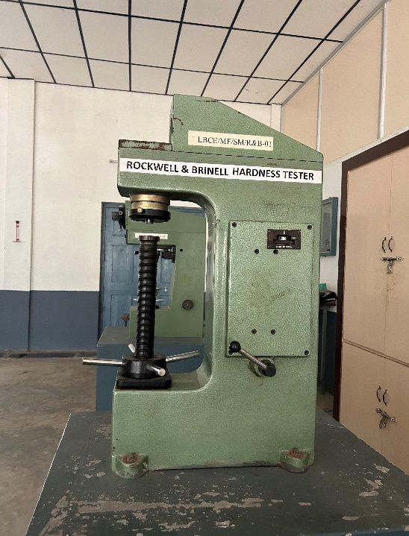
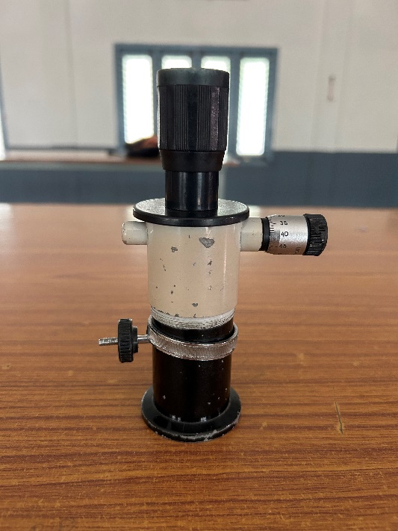
Hardness Test:
The Brinell Hardness Testing Machine is utilized to assess the hardness of Friction Stir Processed Magnesium alloy. Initially, a 5 mm diameter ball indenter is attached, and the workpiece is securely placed on the testing bench. With the lever at position "A" and the dial gauge indicating specific readings, a 250 kgf load is steadily applied by rotating the hand wheel clockwise. After stabilization, the lever is gently returned to position "A," leaving only the initial load engaged. The specimen is then moved, and the impression diameter ("d") is measured using a Brinell microscope for consistent results
Figure 10: Brinell Hardness Testing Machine and Microscope

Slide 30
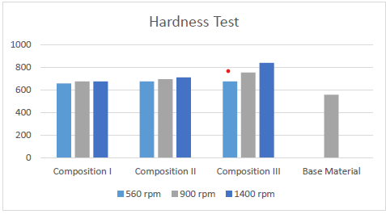
Various hardness values for compositions at different rotational and transversal speeds are tabulated. The base material Mg AZ91 exhibited a hardness of 557.016 N/mm² , while the composite with the lowest hardness was the 1st sample (500 rpm and 25 mm/sec) at 658.796 N/mm². Conversely, the 8th sample (1400rpm and 63 mm/sec) displayed the highest hardness at 839.478 N/mm^{2.}
Figure 10: Graph Showing results for Hardness Test on Specimens with different compositions

Slide 31
Tensile Test:
The ASTM A370 standard was employed for conducting the tensile test using an Instron 5500R machine. Prior to testing, the specimen's dimensions were measured to calculate its cross-sectional area. Gauge length was indicated using various methods like center punch, scribe markings, or ink drawing. The percentage of elongation at break was determined by measuring the distance between gauge marks after fracture. The testing apparatus was zeroed before installing the specimen. Testing speed was determined by measuring crosshead movement or specimen stressing. Yield strength and tensile strength were determined at specified rates. Testing continued until specimen failure, after which broken ends were aligned, and distances between gauge markings were measured. Results were rounded to the nearest 0.05 millimeter.
Figure 11: Tensile Testing Machine

Slide 32
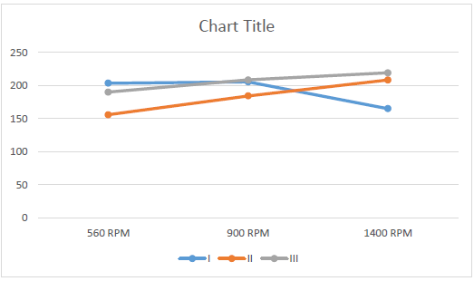
The results for tensile test are shown in the figure 12 replicates the tensile strength of each sample specimen of different compositions and process parameters. It can be concluded that sample 8 has highest tensile strength (TS) of 219.08 MPa, yield strength (YS) of 184.21 MPa and elongation (E) of 14.12%. Figure 13 shows the curves of sample 8.
Figure 12: Result for Tensile test

Slide 33
Figure 13: Load vs Extension and Stress vs Strain curves for sample 8

Slide 34
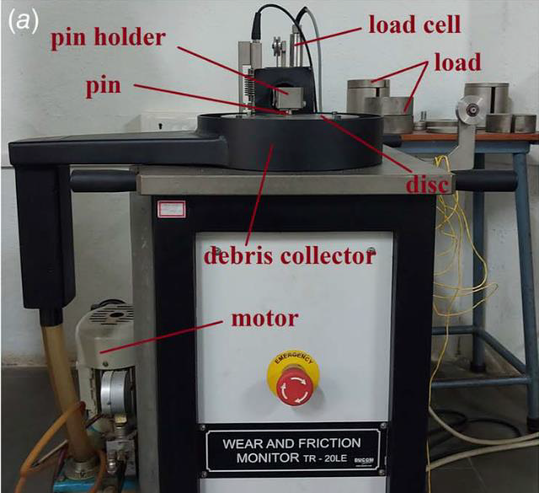
Wear Test:
The Pin-on-disk wear test was conducted following ASTM-G99 standards, focusing on factors like reinforcement percentage (R), distance (D), load (L), and velocity (V) to assess the Wear Rate (WR). The study aimed to explore the influence of different FSP parameters and compositions of nano powder composite on WR. Experiments were performed using pin-on-disc wear testing equipment with a 100 mm track diameter in a controlled laboratory environment. Contact surfaces were prepared by grinding with SiC paper and cleaning with alcohol. The disc was cleaned after each run, and its surface was finished with an alumina abrasive wheel to remove debris. Specimens were thoroughly cleaned, and their weight was measured using a precise electronic balance after each run to calculate WR accurately.
Figure 14:(a) Wear Testing Machine and (b) Workpiece attached to pin holder

Slide 35
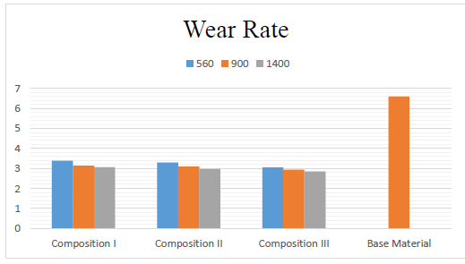
The wear test results indicate that Composition three exhibited the lowest wear rate at 2.856×10-3 mm3/m, significantly lower than the base material's 6.953×10-3 mm3/m. Sample 8 displayed the lowest wear rate, nearly 58% less than the base material. Conversely, Sample 1 showed the highest wear rate at 3.384×10-3 mm3/m.
Sample No. | Load-L (N) | Speed-V(m/s) | Distance-D(m) | Wear Rate (×10-3 mm3/m)
1 | 30 | 2 | 1500 | 3.384
2 | 30 | 2 | 1500 | 3.148
3 | 30 | 2 | 1500 | 3.073
4 | 30 | 2 | 1500 | 2.981
5 | 30 | 2 | 1500 | 3.296
6 | 30 | 2 | 1500 | 3.092
7 | 30 | 2 | 1500 | 2.948
8 | 30 | 2 | 1500 | 2.856
9 | 30 | 2 | 1500 | 3.047
B.M | 30 | 2 | 1500 | 6.953
Figure 15: Wear Rate of Composites table and graphs

Slide 36
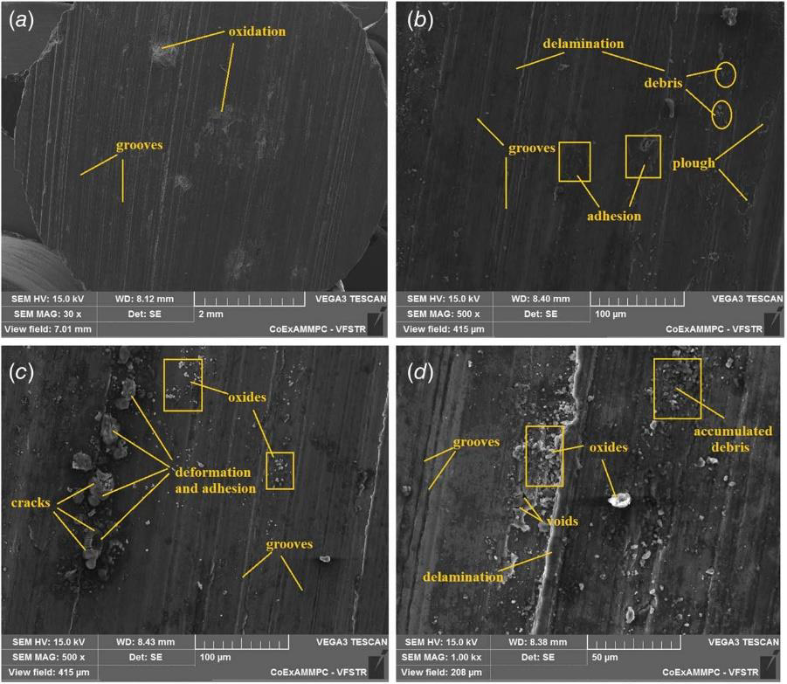
Various wear mechanisms, such as oxidation, adhesion, abrasion, and delamination, affect the composites. Abrasive wear is suggested by parallel grooves observed in Figures 15 (a&b). Plastic deformation led to debris accumulation on the pin's surface, accompanied by the formation of tiny cracks and parallel layers. Delamination wear resulted in cavities and fissures on the worn surface, indicating material surface deformation and crack propagation. Ploughing and crater formation further demonstrated plastic deformation's presence.
(a)
(b)
Figure 15: SEM micrographs of high and low worn-out sample 1 and 8 with different magnifications

Slide 37
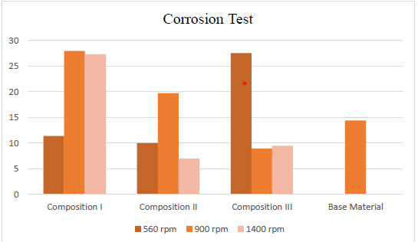
Corrasion Test:
The AZ91 alloy, post-friction stir processing, underwent meticulous corrosion evaluation. Initially, samples were extracted from the treated zone using a wire electrical discharge machine and uniformly ground with emery sheets. Subsequently, they underwent immersion testing for 48 hours in a 3.5% NaCl solution. Samples were then cleansed with distilled water, polished with emery paper to eliminate corrosion elements, and re-cleaned. Dry samples were reweighed to measure corrosion-induced weight variations. Data from this rigorous procedure, revealed the corrosion rate. Analysis from graph indicates that sample 4 exhibited the least weight loss at 6.97%, while samples with equal amounts of aluminum oxide and graphene suffered the highest loss at 27.96%, surpassing the base material's 14.36% loss. This systematic approach provides valuable insights into the corrosion behavior of AZ91 alloy post-friction stir processing.
Sl. No. | Initial Weight | After Test Weight | Weight loss | Weight loss in %
1 | 2.346 | 2.079 | 0.267 | 11.38107
2 | 2.106 | 1.517 | 0.589 | 27.96771
3 | 2.044 | 1.485 | 0.559 | 27.34834
4 | 2.780 | 2.586 | 0.194 | 6.978417
5 | 3.980 | 3.582 | 0.398 | 10
6 | 2.335 | 1.874 | 0.461 | 19.74304
7 | 2.090 | 1.904 | 0.186 | 8.899522
8 | 2.825 | 2.558 | 0.267 | 9.451327
9 | 2.160 | 1.565 | 0.595 | 27.5463
B.M | 2.896 | 2.480 | 0.416 | 14.36464
Figure 16: Weight loss % due to corrosion of specimens

Slide 38
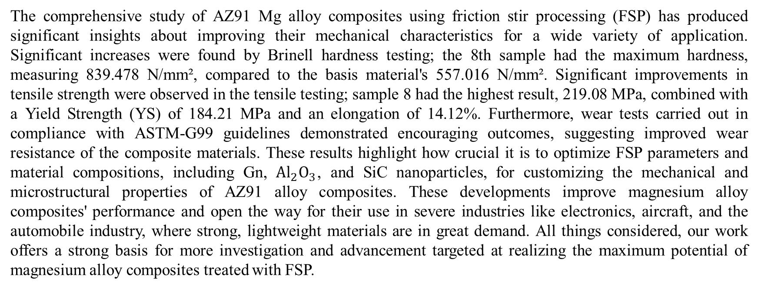
CONCLUSION
The comprehensive study of AZ91 Mg alloy composites using friction stir processing (FSP) has produced significant insights about improving their mechanical characteristics for a wide variety of application. Significant increases were found by Brinell hardness testing; the 8th sample had the maximum hardness, measuring 839.478 N/mm², compared to the basis material's 557.016 N/mm². Significant improvements in tensile strength were observed in the tensile testing; sample 8 had the highest result, 219.08 MPa, combined with a Yield Strength (YS) of 184.21 MPa and an elongation of 14.12%. Furthermore, wear tests carried out in compliance with ASTM-G99 guidelines demonstrated encouraging outcomes, suggesting improved wear resistance of the composite materials. These results highlight how crucial it is to optimize FSP parameters and material compositions, including Gn, ${Al}_{2}O_{3}$, and SiC nanoparticles, for customizing the mechanical and microstructural properties of AZ91 alloy composites. These developments improve magnesium alloy composites' performance and open the way for their use in severe industries like electronics, aircraft, and the automobile industry, where strong, lightweight materials are in great demand. All things considered, our work offers a strong basis for more investigation and advancement targeted at realizing the maximum potential of magnesium alloy composites treated with FSP.

Slide 39
REFERENCE
Mishra, R. S., Ma, Z. Y., & Charit, I. (2003). Friction stir processing: a novel technique for fabrication of surface composite. Materials Science and Engineering: A, 341(1–2), 307-310. https://doi.org/10.1016/S0921-5093(02)00199-5
Heidarzadeh, A., Mironov, S., Kaibyshev, R., Çam, G., Simar, A., Gerlich, A., ... Withers, P. J. (2021). Friction stir welding/processing of metals and alloys: A comprehensive review on microstructural evolution. Progress in Materials Science, 117, 100752. https://doi.org/10.1016/j.pmatsci.2020.100752
Dadashpour, M., Mostafapour, A., Yeşildal, R., & Rouhi, S. (2016). Effect of process parameter on mechanical properties and fracture behavior of AZ91C/SiO2 composite fabricated by FSP. Materials Science and Engineering: A, 655, 379-387. https://doi.org/10.1016/j.msea.2015.12.103
Hassanamraji, N., Eivani, A. R., & Aboutalebi, M. R. (2021). Finite element simulation of deformation and heat transfer during friction stir processing of as-cast AZ91 magnesium alloy. Journal of Materials Research and Technology, 14, 2998-3017. https://doi.org/10.1016/j.jmrt.2021.08.087
Singh, U.-K.; Dubey, A.-K. Study of Weld Characteristics in Friction Stir Welding of Dissimilar Mg-Al-Zn Magnesium Alloys under Varying Welding Conditions. J. Mater. Eng. Perform. 2021, 30, 7690–7703. http://doi.org/10.1007/s11665-021-05893-z

Slide 40
Sudhakar, M., Stanley, A. I., Suri, K. S. V., Sai, B. S., Anil, D., Rao, Y. V., Basha, S., Vikas, C., & Charan,
K. S. (2023). Friction Stir Processing Of AZ91 Magnesium Alloy and Effect of Process Parameters. International Journal of Advances in Engineering and Management (IJAEM), 5(4), 661-667. https://ijaem.net/issue_dcp/Friction%20Stir%20Processing%20OFAZ91%20Magnesium%20Alloy%20and
%20Effect%20of%20Process%20Parameters.pdf
Faraji, G., & Asadi, P. (2011). Characterization of AZ91/alumina nanocomposite produced by FSP.
Materials Science and Engineering: A, 528(6), 2431-2440. https://doi.org/10.1016/j.msea.2010.11.065
Sidhu, H. S., Singh, B., & Kumar, P. (2021). To study the corrosion behavior of friction stir processed magnesium alloy AZ91. Materials Today: Proceedings, 44(6), 4633-4639. https://doi.org/10.1016/j.matpr.2020.10.920
Heidarpour A, Ahmadifard S, Rohani N (2018) FSP pass number and cooling effects on the microstructure and properties of AZ31. J Adv Mater Process:47–58
Asadi, P., Besharati Givi, M. K., Parvin, N., Araei, A., Taherishargh, M., & Tutunchilar, S. (2012). On the role of cooling and tool rotational direction on microstructure and mechanical properties of friction stir processed AZ91. International Journal of Advanced Manufacturing Technology, 63, 987–997. https://doi.org/10.1007/s00170-012-3971-0
Bagheri, B., Abbasi, M., Abdollahzadeh, A., & Mirsalehi, S. E. (2020). Effect of second-phase particle size and presence of vibration on AZ91/SiC surface composite layer produced by FSP. Transactions of Nonferrous Metals Society of China, 30(4), 905-916. https://doi.org/10.1016/S1003-6326(20)65264-5

